Slide 1
SPIKE + XBOX RYSE
2013 PARTNERSHIP SUMMARY

Slide 2
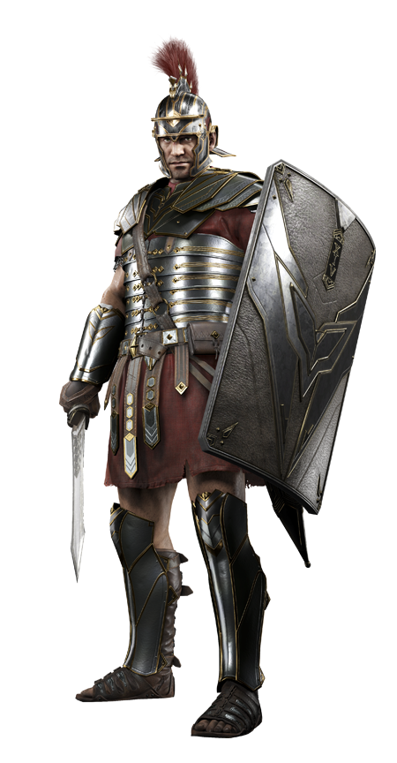
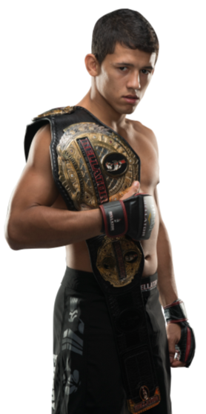
RYSE + BELLATOR
Spike and Xbox’s Ryse: Son of Rome partnered together in a robust and custom program anchored in Bellator, paralleling the synergies with the game’s gladiator thematic and Bellator’s gladiator roots.
Three integral components were identified as metrics for success:
Develop truly cobranded assets.
Seamlessly integrate features and benefits that both Ryse: Son of Rome and Bellator have to offer.
Showcase the cinematic look and feel of the game in everything created.

Slide 3
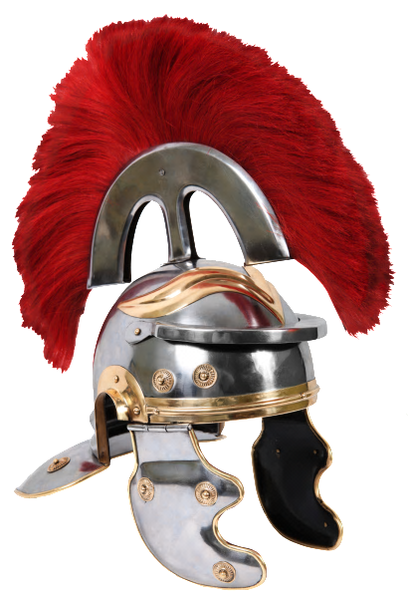
RYSE TO THE TOP PARTNERSHIP
Microsoft and Spike produced a vignette series that seamlessly aligned the Bellator and RSOR properties by highlighting immersive gameplay with background and key messaging points. These compelling vignettes focused on the advent of Marius in Ryse, as it perfectly mirrored the stories of Bellator MMA athletes battling to the top, and also reflected the cinematic and epic visual quality of the game:
CUSTOM CONTENT: 6x custom vignette series
ON AIR: custom content taking over pods within Bellator, Fight Replay ownership, custom cobrands, promos and tune ins
DIGITAL/SOCIAL: custom content housed on dedicated page, with social and digital promotion to the partnership
BELLATOR APP: exclusive sponsorship of live fight feature
ON THE GROUND: mat signage, cage post, in arena announcements, weigh ins, and press exposure
ATHLETE SPONSORSHIP
Notes:
On Air: 6 pieces of custom content (up to a :90 piece) will run paired with :30 brand commercial. In addition, Ryse will be featured in-show in fight replay segments, mentioned verbally by Bellator in-cage announcer in-fight, and integrated into branded tune-ins and billboards
Digital: Content pieces created for on-air to be featured on Bellator MMA show page for the period of promotion (October-December), Ryse site/social media fan pages, and other platforms (i.e. BING, MSFT Channel, YouTube, etc.). Social will drive/promote custom content, and be stunted to align with sponsored fights.
App: Ryse will sponsor the live fight section of the app and have media within the app for 6 weeks.
On-the-Ground: Ryse will be integrated into 6 live fights including mat signage and cage posts and in arena commercials.

Slide 4
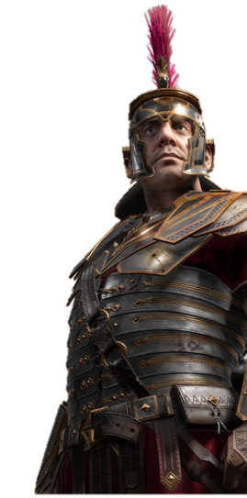
RYSE TO THE TOP:
CUSTOM VIGNETTES

Slide 5
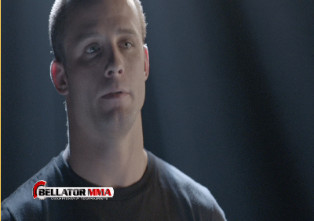
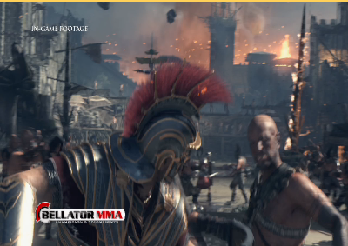
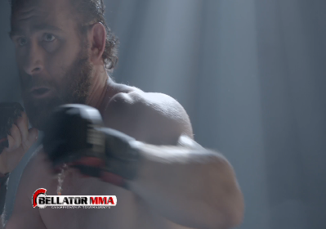
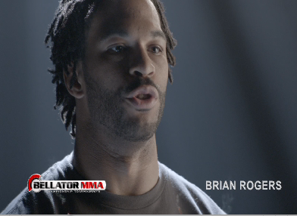
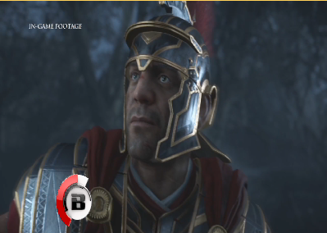
CUSTOM VIGNETTE SERIES:
RYSE TO THE TOP CREATIVE EXECUTIONS (x6)
MICROSOFT AND BELLATOR EXECUTED AN UNPRECEDENTED CUSTOM MULTIPLATFORM PROGRAM, BLENDING TOGETHER MICROSOFT SON RYSE OF ROME AND BELLATOR FIGHTERS IN 6X :90 SECOND CUSTOM CONTENT VIGNETTES
VIGNETTE 1:
PAT CURRAN
VIGNETTE 2:
EMANUEL NEWTON
VIGNETTE 3:
BRETT COOPER
VIGNETTE 4:
BRIAN ROGERS
VIGNETTE 5:
COMPILATION 1
VIGNETTE 6:
COMPILATION 2
Notes:
http://portal/sites/adsales/entertainment/Lists/Video%20List/Custom_DispForm.aspx?List=722b807c-1e4c-4287-aa1f-35409c6dce7e&ID=1286&Source=http%3A%2F%2Fportal%2Fsites%2Fadsales%2Fentertainment%2FPages%2FVideoSearchPage%2Easpx

Slide 6
RYSE TO THE TOP:
ON AIR

Slide 7
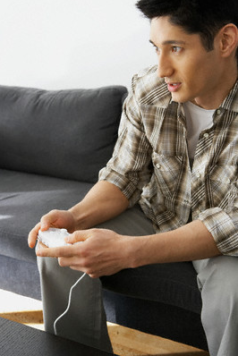
ON AIR:
YOU REACHED GAMERS
DURING THE SIX BELLATOR FIGHTS ON SPIKE, XBOX ONE TRULY CAPTURED THE ATTENTION OF GAMERS.
M18-49 SPIKE VIEWERS ACROSS THE CAMPAIGN ARE…
More than THREE times as likely as the average U.S. adult to have spent $400+ on video systems(322 index)
Almost TWICE as likely to have spent $100+ on video games (191 index)
Almost FIFTY PERCENT more likely to be a heavy video game user (149 index)
Source: Nielsen Npower/MRI Fusion. Base P18+ permanent resident. Bellator MMA (10/18-11/22 premiere airings, 5 telecasts), Chandler vs. Alvarez II (11/2 9p+10:15p part 1+2 premiere airings, 11/8 8p repeat airing).

Slide 8
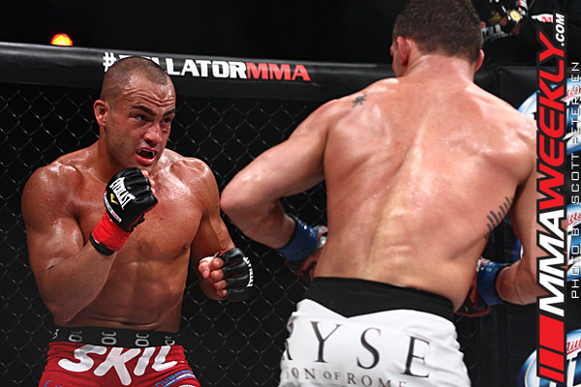
ON AIR:
BELLATOR DELIVERS FOR RYSE SON OF ROME
BELLATOR WAS TOP 15 ON CABLE IN ITS TIME PERIOD DURING EACH RYSE SPONSORED FIGHT
11/2 CHANDLER VS. ALVAREZ WAS THE HIGHEST RATED AND MOST WATCHED BELLATOR EVENT EVER
Nearly 1.2 million viewers
Top 5 program in its time period on
cable with virtually all key demos
(Ranked #2 on M18-49 and #5 on
M18-34)

Slide 9
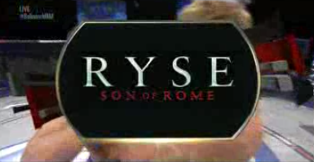
ON AIR:
CUSTOM VIGNETTES + FIGHT REPLAY
RYSE FEATURED IN 6 BELLATOR FIGHTS FROM 10/18-11/22, WITH CUSTOM RYSE TO THE TOP VIGNETTES AND FIGHT REPLAY SPONSORSHIP:
The Ryse to the Top vignettes aired during six Bellator fights with each week’s promotion including:
1x 2:00 minute pod takeover in Season 9 Bellator per fight
:90 custom creative followed by :30 Ryse commercial creative
3x aired on 11/2 free fight in place of PPV
IN-SHOW FEATURED FIGHT REPLAY SEGMENTS
1x Fight Replay feature segment (in show) per sponsored fight (6x total) allowing fans to witness the key moments and winning move of each match
Notes:
http://portal/sites/adsales/entertainment/Lists/Video%20List/Custom_DispForm.aspx?List=722b807c-1e4c-4287-aa1f-35409c6dce7e&ID=1279&Source=http%3A%2F%2Fportal%2Fsites%2Fadsales%2Fentertainment%2FPages%2FVideoSearchPage%2Easpx

Slide 10
ON AIR:
CUSTOM TUNE INS & BILLBOARDS
Custom tune-ins and call-to-action bursts integrated RSOR key branding and messaging including:
Bumpers driving to GT App on Xbox Live to watch Prelims
1x Bellator shared billboard tagged with Ryse logo and messaging
1x :05 Billboard airing during each live Bellator fight 10/18, 10/25, 11/2, 11/8, 11/22
:30 Bellator custom tune-ins (guaranteed 45 across entire the flight)
OVER DELIVERING CUSTOM TUNE IN FREQUENCY
48 TOTAL AIRINGS
Notes:
http://portal/sites/adsales/entertainment/Lists/Video%20List/Custom_DispForm.aspx?List=722b807c-1e4c-4287-aa1f-35409c6dce7e&ID=1256&Source=http%3A%2F%2Fportal%2Fsites%2Fadsales%2Fentertainment%2FPages%2FVideoSearchPage%2Easpx

Slide 11
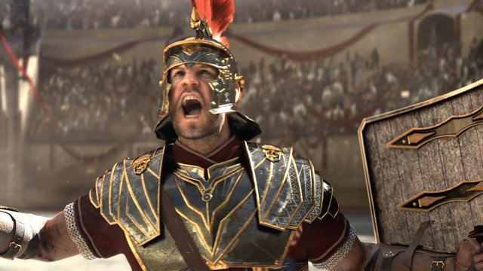
SPIKE DELIVERS TREMENDOUS REACH
MICROSOFT’S RYSE CAMPAIGN REACHED OVER 15 MILLION VIEWERS ON AIR.
Reached 4.7M M18-49
Reached 2.4M M18-34
Reached 8.1M P18-49
Reached 4.2M P18-34
Additionally, each viewer was exposed to Microsoft’s message nearly 2 times.
Source: NMR C3 data. MSFT campaign = Xbox Ryse, 10/12 through 11/22. Reach based on 1 min qualifier.

Slide 12
RYSE TO THE TOP:
DIGITAL

Slide 13
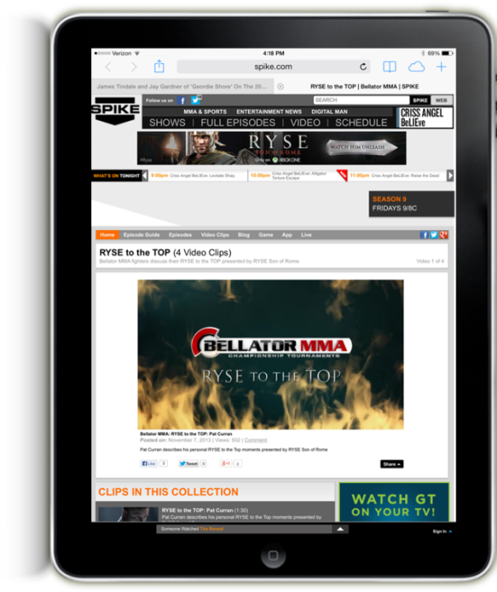
DIGITAL:
CUSTOM VIGNETTES
7,549 Total Streams Across Platforms!*
The Ryse to the Top vignette series lived across multiple screens including desktop, mobile web and within the Bellator app.
Daily Streams:
+35% higher than average
Average time spent per visitor on clips :40.4
Source: Omniture SiteCatalyst, 10/18/13—12/16/13, *streams include desktop, mobile web, iOS app and viral)
Source: Omniture SiteCatalyst, 9/7/13—11/22/13 vs. 1/17/13—4/4/13)
Notes:
http://www.spike.com/video-collections/1bajzj/bellator-mma-ryse-to-the-top/7hxf3c
http://www.spike.com/video-collections/1bajzj/bellator-mma-ryse-to-the-top/7hxf3c

Slide 14
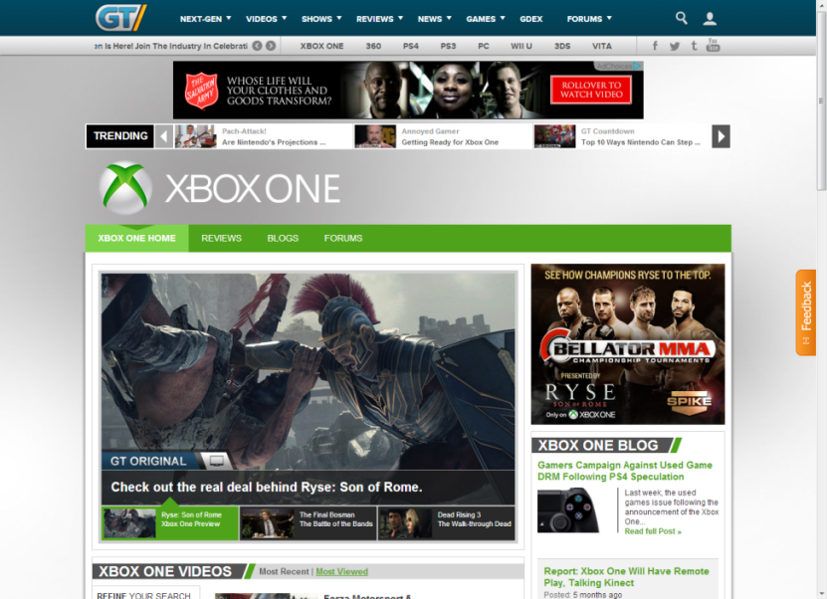
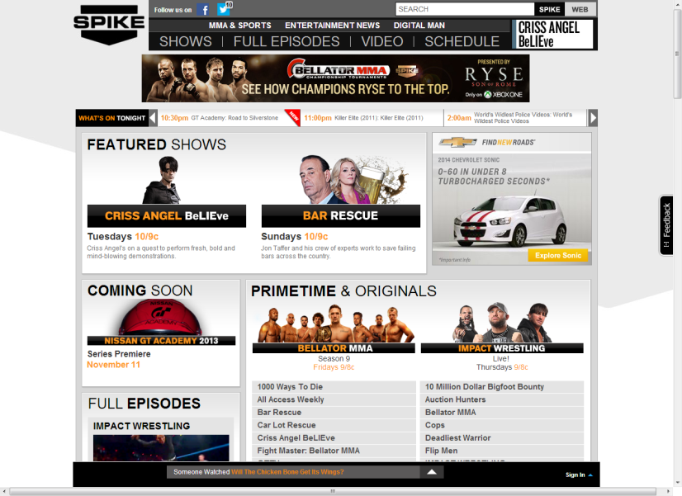
DIGITAL:
GETTING THE WORD OUT
Editorial promotion and custom co-brands, running across VMNE, drove fans to the Ryse to the Top Custom Vignette Collection giving XBOX Ryse even greater reach.
Ryse to the Top Daily 4 Promo received more than 624M Page Views
(Source: Omniture SiteCatalyst, November-December 2013) 11/11/13—12/16/13

Slide 15
RYSE TO THE TOP:
MOBILE

Slide 16
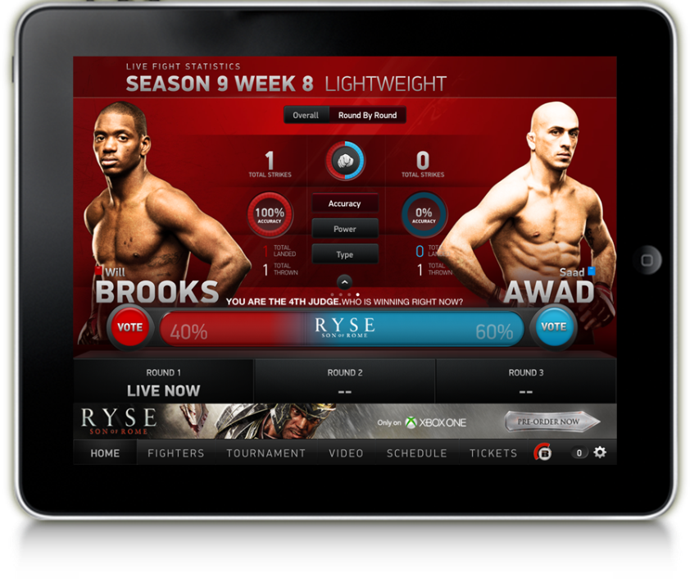
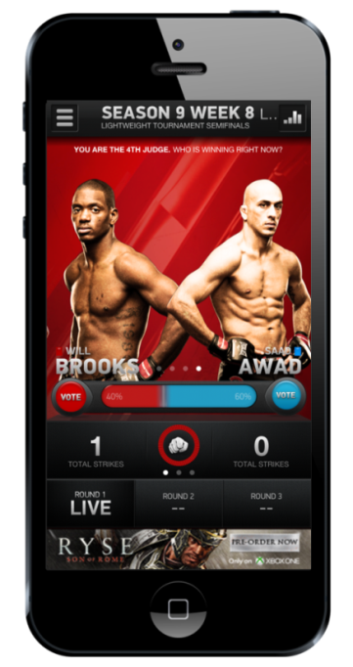
DIGITAL:
BELLATOR APP
164K+
+10%
+28%
+16%
APP DOWNLOADS
WEEKLY VISITS
WEEKLY VIDEO STREAMS
WEEKLY VOTES
During the campaign flight:
visits increased12%
votes increased 22%
video streams increased 12%
Source: Weekly Bellator reports, Omniture, Cube

Slide 17
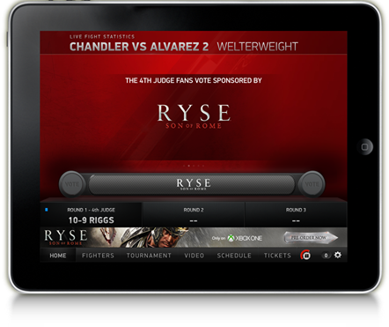
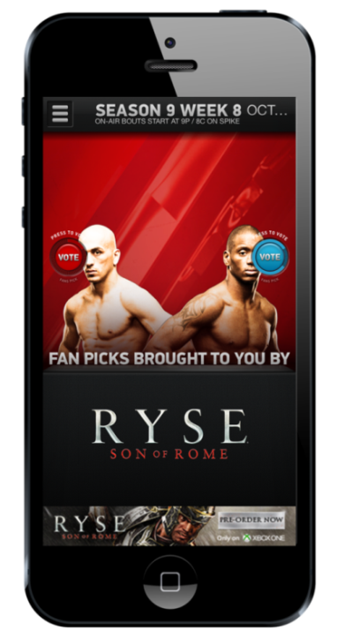
DIGITAL:
BELLATOR APP – KEY FIGHTS DURING RYSE FLIGHT
11/2 CHANDLER VS. ALVAREZ
The biggest fight of the season on November 2nd (Chandler vs. Alvarez) generated:
46% growth in app visits
12% growth in video streams
98% growth the MOST votes casted ever during a fight
11/15 JACKSON VS. BELTRAN
The November 15 fight saw week
over week growth:
+21% Mobile Streams
+22% Tablet Streams
Source: Weekly Bellator reports, Omniture, Cube

Slide 18
RYSE TO THE TOP:
SOCIAL

Slide 19
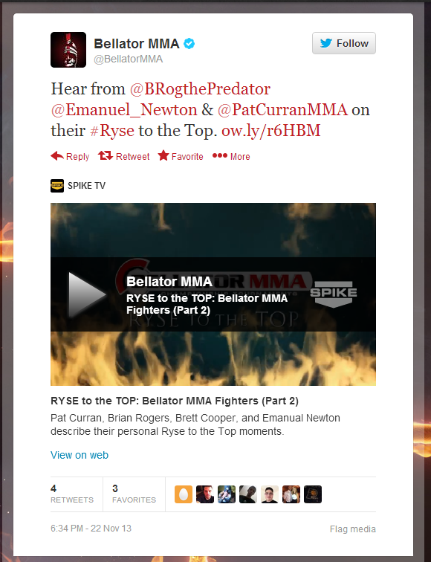
DIGITAL:
SOCIAL PROMOTION
SOCIAL PROMOTION THAT SUPPORTED ALL PARTNERSHIP INITIATIVES:
PROMOTION OF CUSTOM RYSE CONTENT
PROMOTION OF BELLATOR APP DRIVING TO LIVE FIGHT SECTION
XBOX SOCIAL PROMOTION
TALENT PROMOTION
8.8% increase in Bellator MMA Twitter followers during the Ryse campaign
26% increase in Bellator MMA Facebook Fans during the Ryse campaign
199% Growth in Tweets/Social mentions of Bellator MMA content since 2Q’13
(Source: TwitterCounter, 12/16/13 vs. 10/18/13; Facebook Analytics, 12/15/13 vs. 10/18/13)
*Social impressions defined by industry accepted calculations below:
Facebook: Utilizing the Facebook Administrator to total likes, shares, comments and reach equals the impressions
Twitter: 15% of each handle's followers + RTs and favorites totals the impressions per post

Slide 20
DIGITAL:
SOCIAL PROMOTION
PULSE OF THE CONVERSATION
13
total social posts from the BellatorMMA Twitter and Spike TV Facebook and Twitter accounts
TALENT PROMOTION
2
retweets from Pat Curran to his twitter following
CUSTOM BRANDED HASHTAG
#RyseSOR
Over 400M Earned Media Impressions!*
Use of branded hashtag in Spike promotional tweets
ATTACHED TO THE MOST TALKED ABOUT FIGHT
#1
11/2 Chandler v. Alvarez was the most social program for the day in ALL TV with 24k mentions

Slide 21
RYSE TO THE TOP:
ON THE GROUND

Slide 22
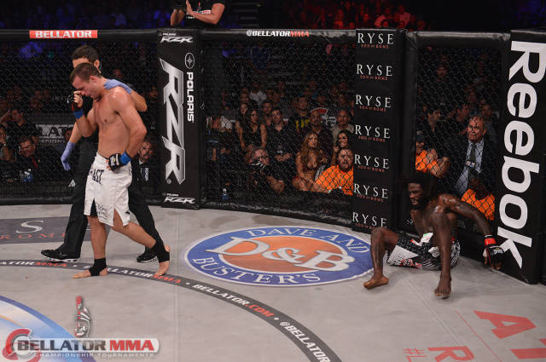
ON THE GROUND:
ON SITE/IN ARENA
Ryse on-site integration throughout Season 9 tournament coverage including:
Ryse branding on mat signage and cage posts
Televised in-cage announcements driving fans online for more “Stories of the Ryse” content
In-arena commercials
RECEIVED:
2x side mat logos and 2x vertical posts per fight
3x fight replay feature segments per fight
1x in-ring announcement per flight
Notes:
http://portal/sites/adsales/entertainment/Lists/Video%20List/Custom_DispForm.aspx?List=722b807c-1e4c-4287-aa1f-35409c6dce7e&ID=1256&Source=http%3A%2F%2Fportal%2Fsites%2Fadsales%2Fentertainment%2FPages%2FVideoSearchPage%2Easpx

Slide 23
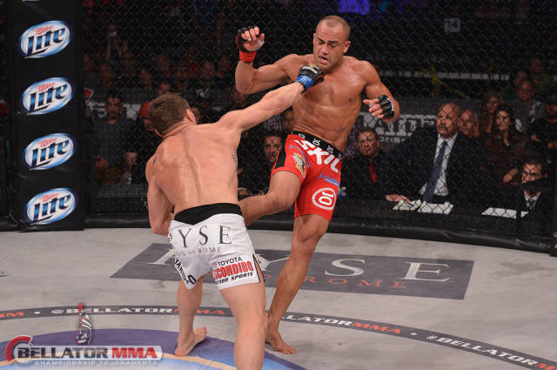
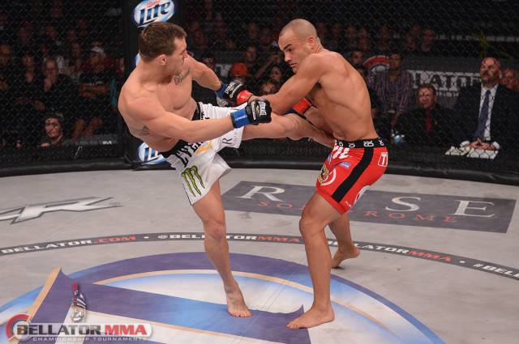
ON THE GROUND:
ATHLETE SPONSORSHIP
Ryse also sponsored fighter shorts for Pat Curran and Michael Chandler for the 11/2 fight
M18-49 rating for entire telecast: .639
M18-49 rating during Curran vs. Straus fight: .667 (+4% vs. full telecast)
M18-49 rating during Chandler vs. Alvarez fight: .890 (+39% vs. full telecast)
Curran on-air trunk exposure time:
36 minutes
Chandler on-air trunk exposure time:
34 minutes

Slide 24
APPENDIX

Slide 25
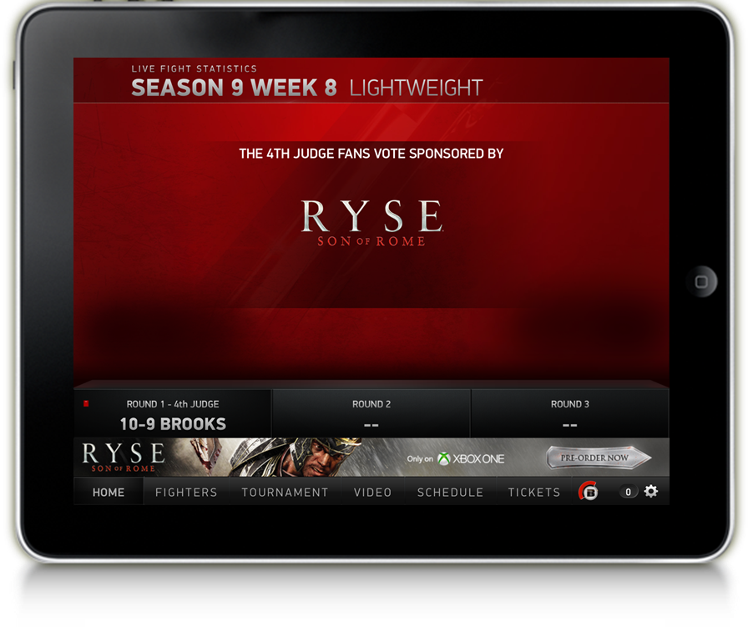
Category Exclusive Sponsorship of Bellator MMA App

Slide 26
Logo Integration within "Live Fight" Feature of Bellator App on Mobile & Tablet

Slide 27
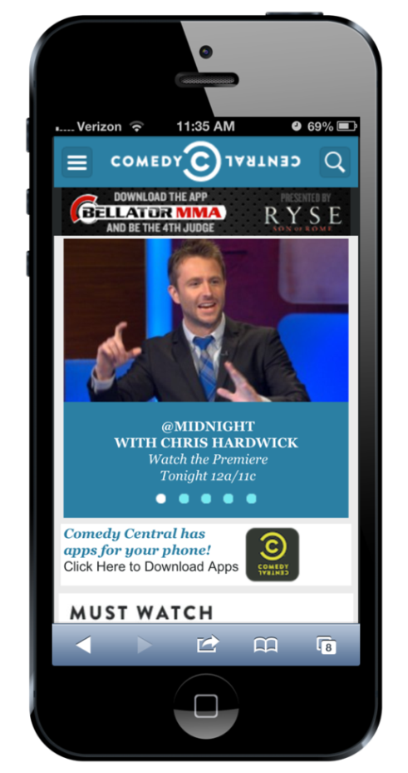
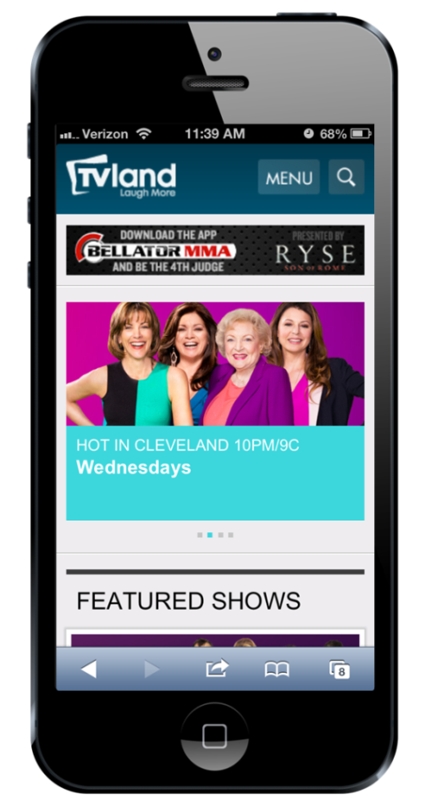
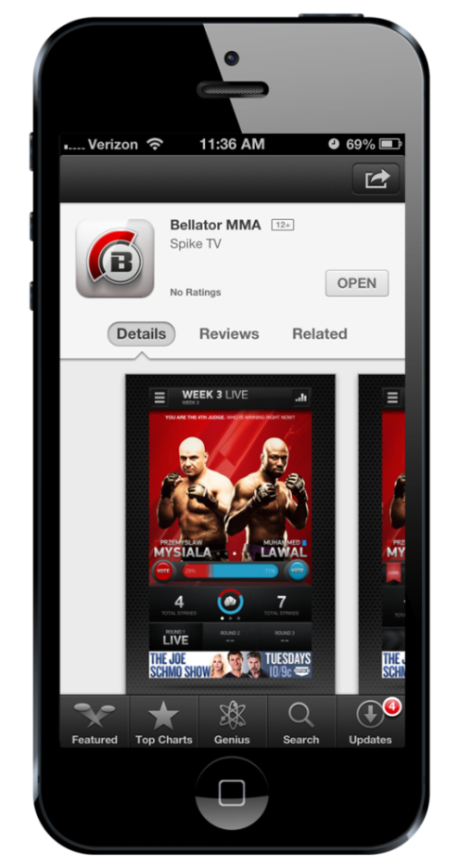
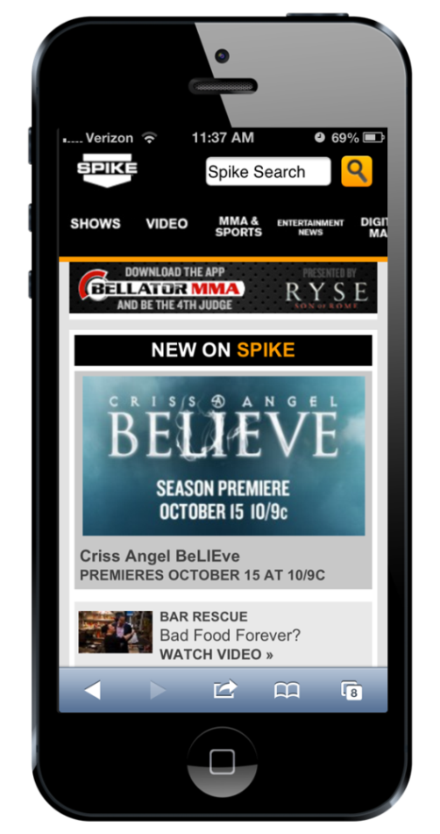
Custom Mobile Co-Brands Driving to Bellator App Across VMN Entertainment Group Mobile

Slide 28
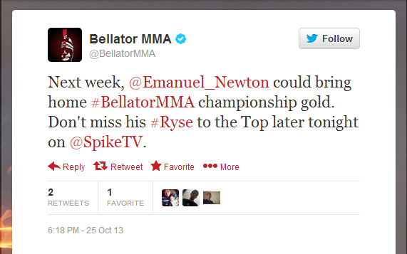
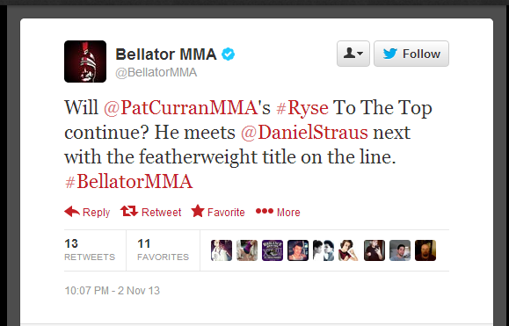
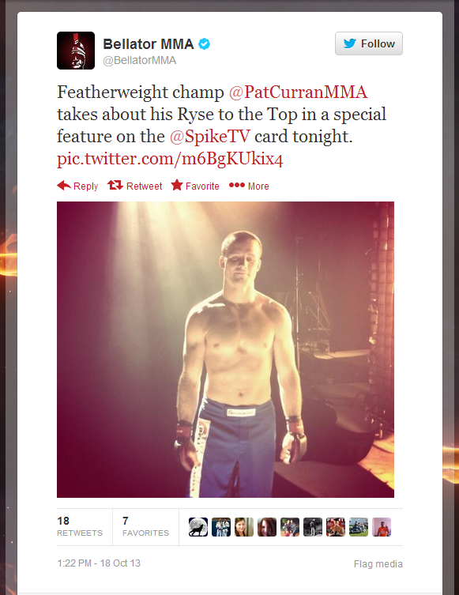
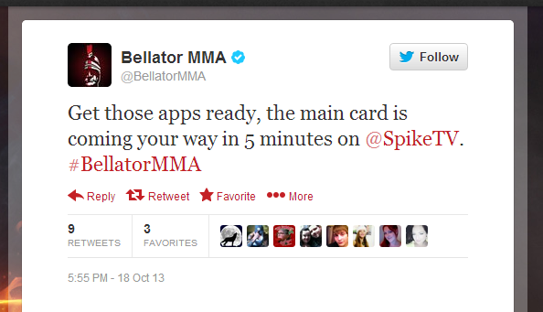
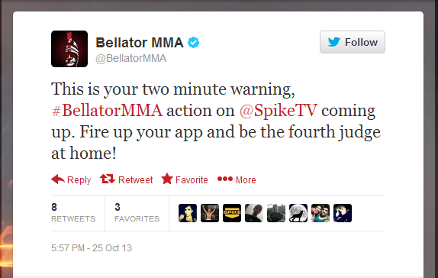
Social Promotion: Promotion of Bellator App Driving to Live Fight Section
Notes:
11/22
https://twitter.com/BellatorMMA/status/404067459168100352
https://twitter.com/BellatorMMA/status/404075564849324032
11/15
https://twitter.com/BellatorMMA/status/401524497108697088
11/11 (Spike Tweet & BellatorMMA Retweet)
https://twitter.com/SpikeTV/status/400096404921942016
https://www.facebook.com/Spike/posts/10151958052692159
11/2
https://twitter.com/BellatorMMA/status/396820970670809089
https://twitter.com/BellatorMMA/status/396799513827868672
10/25
https://twitter.com/BellatorMMA/status/393932019228360705
https://twitter.com/BellatorMMA/status/393909370376814592
https://twitter.com/BellatorMMA/status/393904295319314433
10/18
https://twitter.com/BellatorMMA/status/391366907624177665
https://twitter.com/BellatorMMA/status/391298160166842368
9/25
https://twitter.com/BellatorMMA/status/383006928156106754

Slide 29
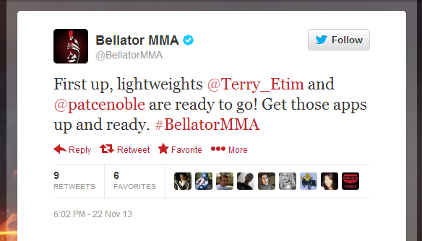
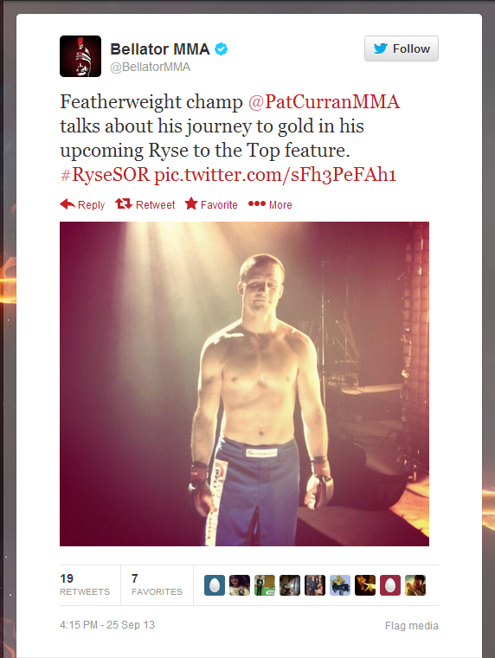
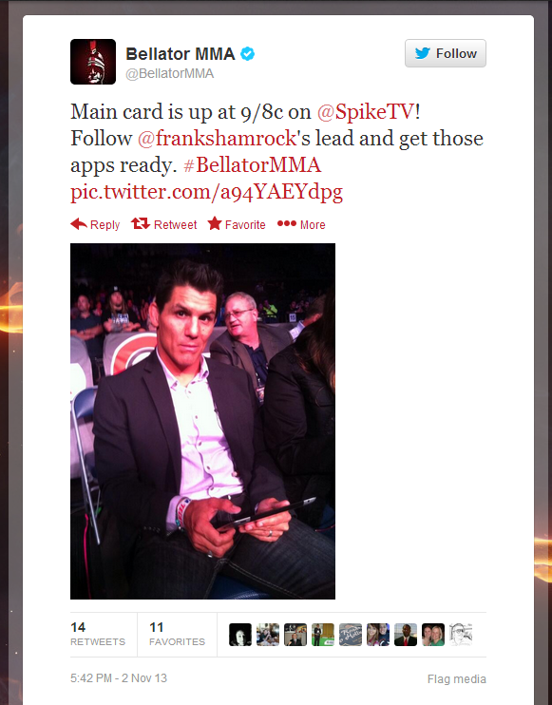
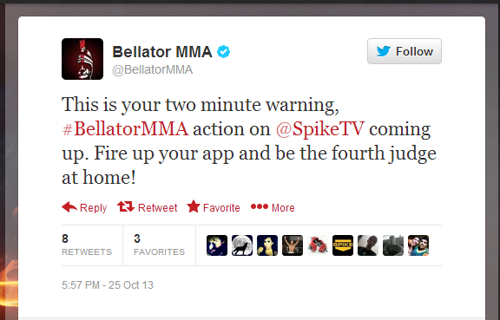
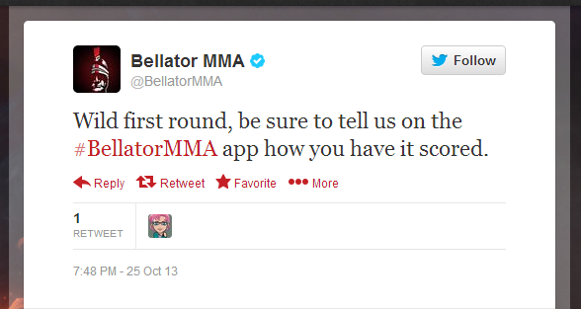
Social Promotion: Promotion of Bellator App Driving to Live Fight Section
Notes:
11/22
https://twitter.com/BellatorMMA/status/404067459168100352
https://twitter.com/BellatorMMA/status/404075564849324032
11/15
https://twitter.com/BellatorMMA/status/401524497108697088
11/11 (Spike Tweet & BellatorMMA Retweet)
https://twitter.com/SpikeTV/status/400096404921942016
https://www.facebook.com/Spike/posts/10151958052692159
11/2
https://twitter.com/BellatorMMA/status/396820970670809089
https://twitter.com/BellatorMMA/status/396799513827868672
10/25
https://twitter.com/BellatorMMA/status/393932019228360705
https://twitter.com/BellatorMMA/status/393909370376814592
https://twitter.com/BellatorMMA/status/393904295319314433
10/18
https://twitter.com/BellatorMMA/status/391366907624177665
https://twitter.com/BellatorMMA/status/391298160166842368
9/25
https://twitter.com/BellatorMMA/status/383006928156106754

Slide 30
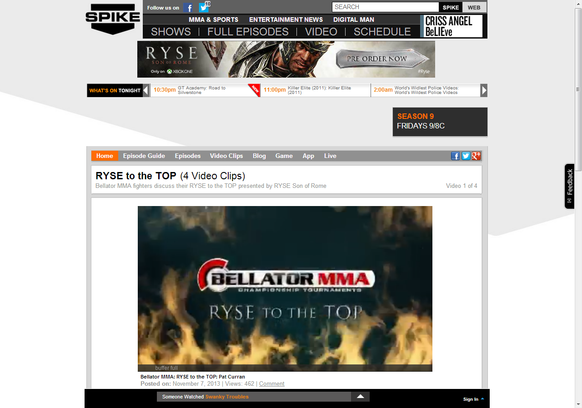
Playlist of custom Stories of Ryse Videos

Slide 31
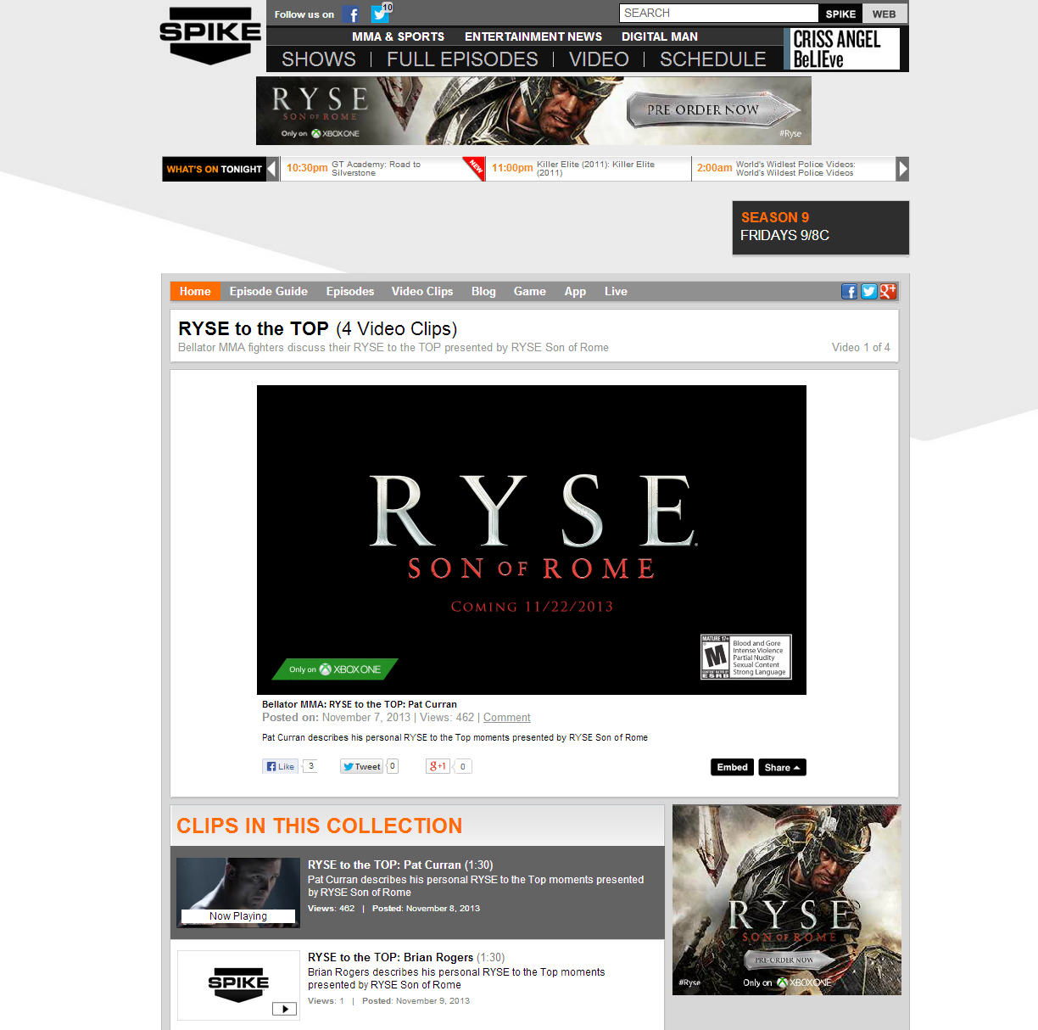
Added Value 728x90 Banner Fixed to Custom Playlist

Slide 32
Added Value 300x250 Banner Fixed to Custom Playlist

Slide 33
Custom Intro Slate Fixed to Custom Playlist

Slide 34
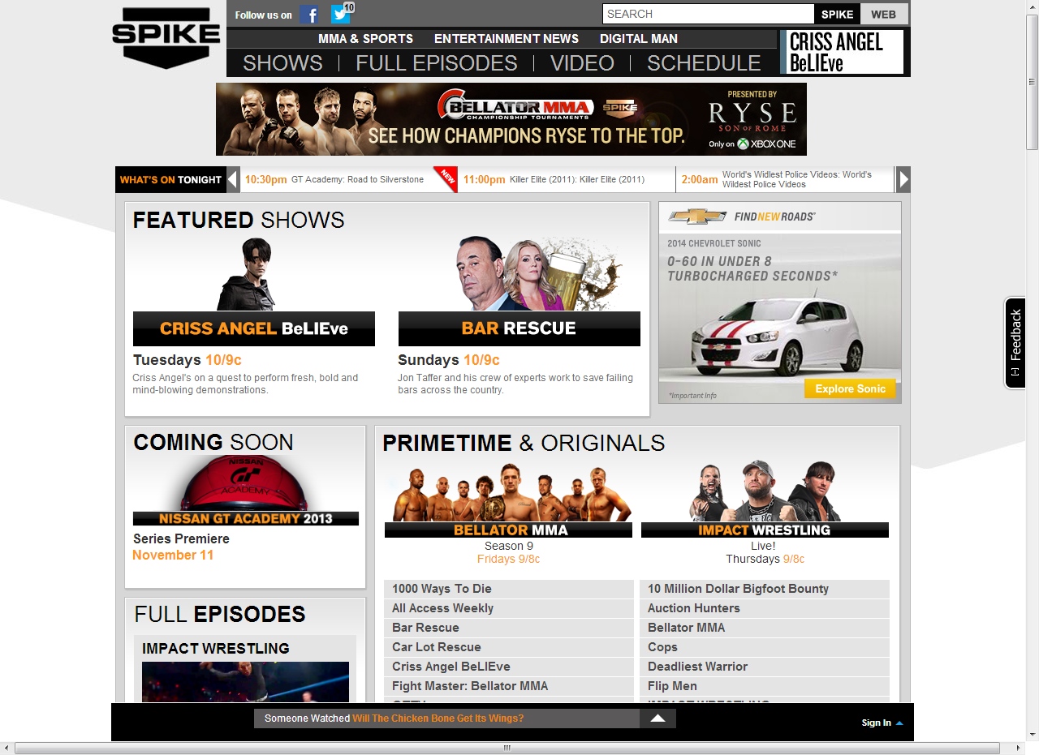
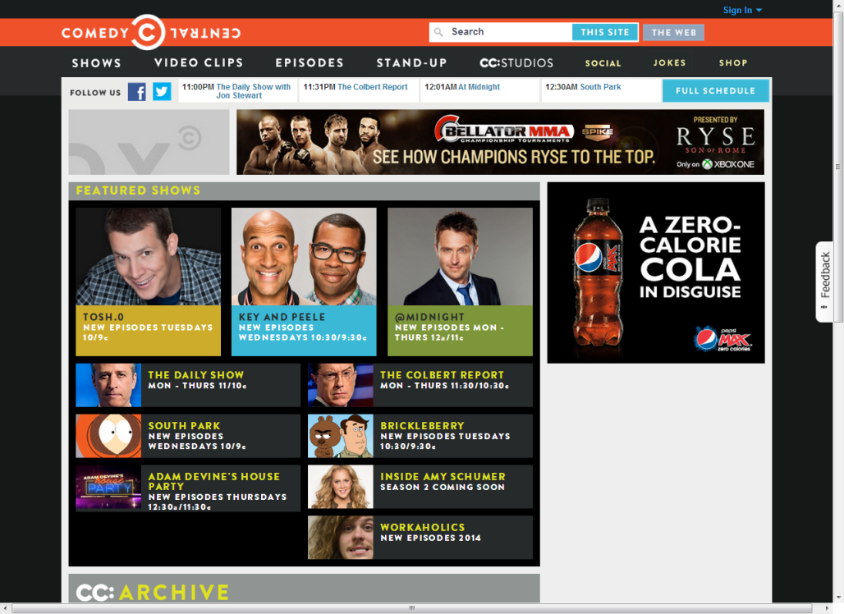
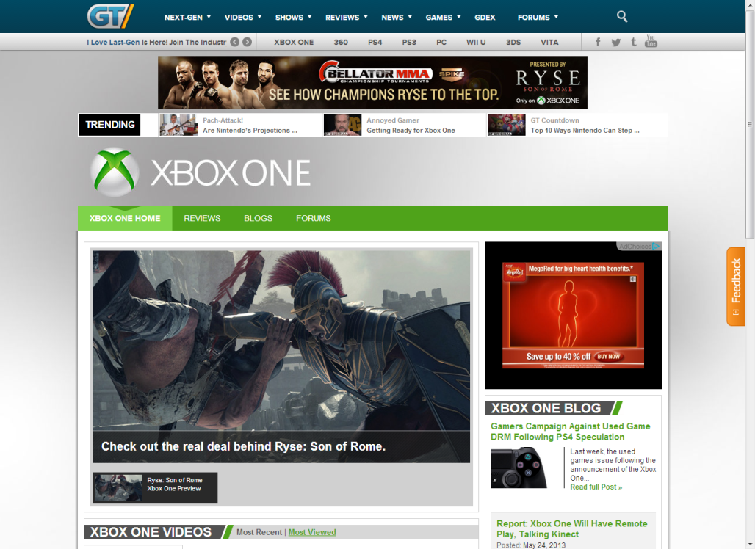
Custom Co-Branded 728x90 Driving to Custom Playlist

Slide 35
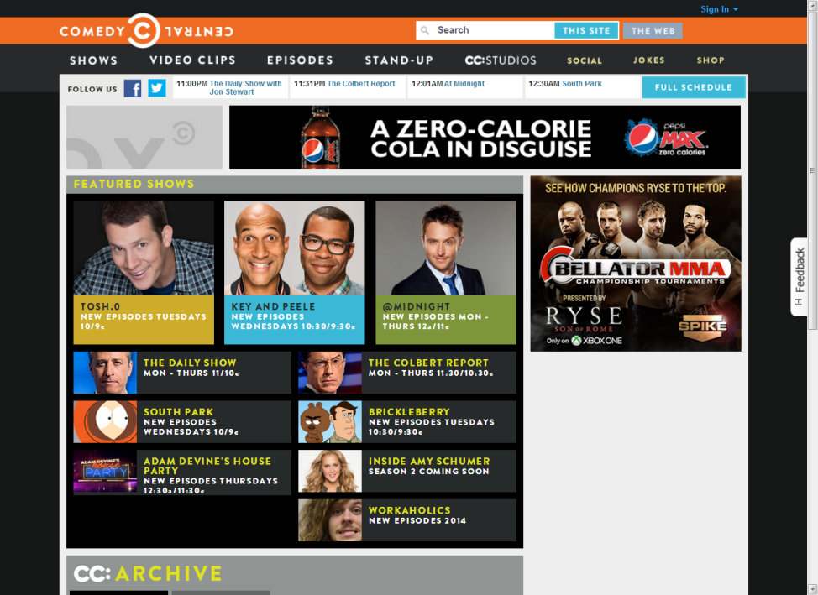
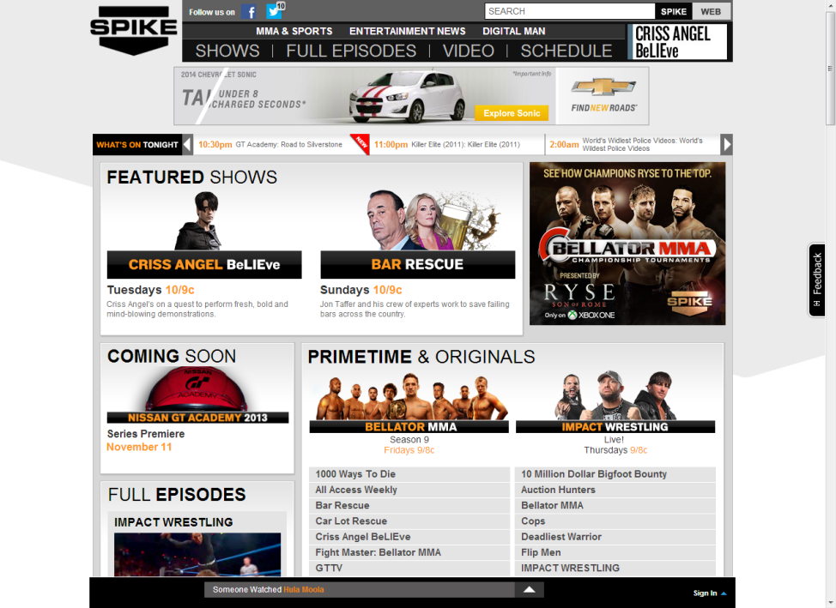
Custom Co-Branded 300x250 Driving to Custom Playlist

Slide 36
Custom Daily Four Button on Spike.com Homepage Driving to Custom Playlist

Slide 37
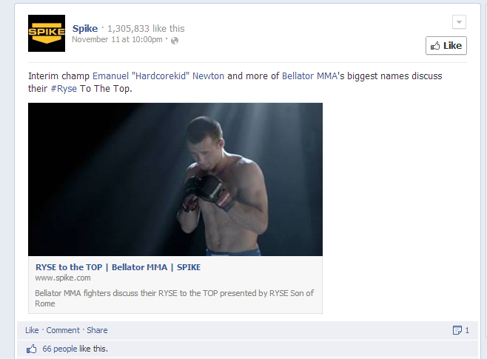
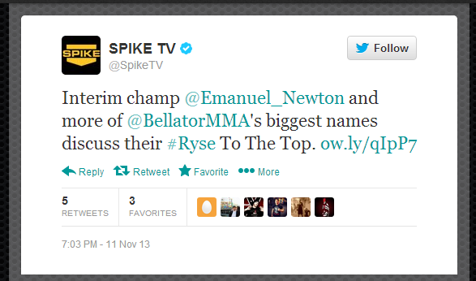
Social Promotion of Custom Ryse Content
Notes:
11/22
https://twitter.com/BellatorMMA/status/404067459168100352
https://twitter.com/BellatorMMA/status/404075564849324032
11/15
https://twitter.com/BellatorMMA/status/401524497108697088
11/11 (Spike Tweet & BellatorMMA Retweet)
https://twitter.com/SpikeTV/status/400096404921942016
https://www.facebook.com/Spike/posts/10151958052692159
11/2
https://twitter.com/BellatorMMA/status/396820970670809089
https://twitter.com/BellatorMMA/status/396799513827868672
10/25
https://twitter.com/BellatorMMA/status/393932019228360705
https://twitter.com/BellatorMMA/status/393909370376814592
https://twitter.com/BellatorMMA/status/393904295319314433
10/18
https://twitter.com/BellatorMMA/status/391366907624177665
https://twitter.com/BellatorMMA/status/391298160166842368
9/25
https://twitter.com/BellatorMMA/status/383006928156106754

Slide 38
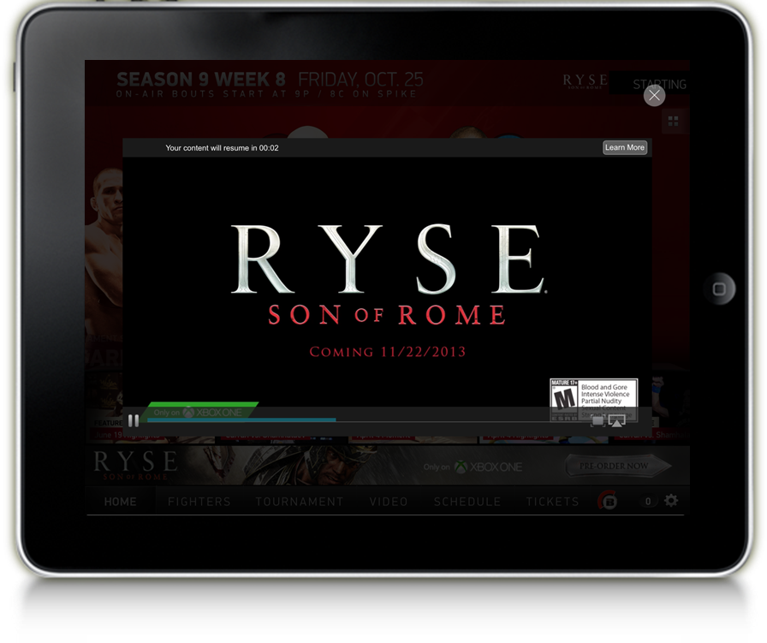
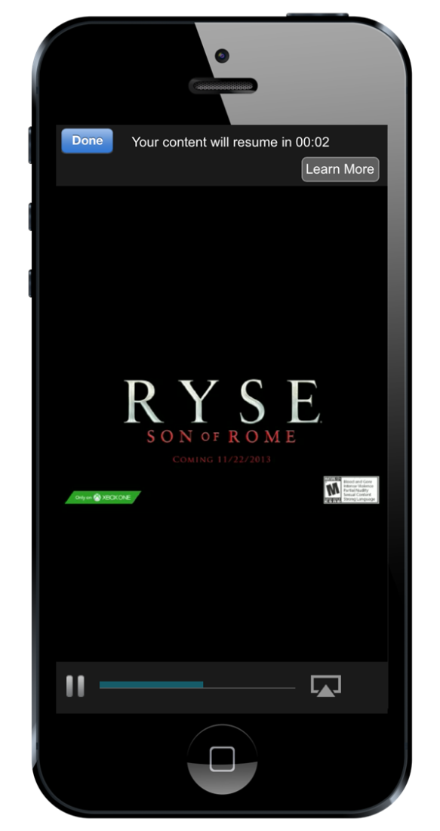
Custom Intro Slate Across Sponsored Mobile/Tablet Content

Slide 39
300x50 Mobile Banner Fixed to Bellator MMA App "Live Fight" Feature

Slide 40
1024x66 Tablet Banner Fixed to Bellator MMA App "Live Fight" Feature

Slide 41
Gametrailers.com Homepage Roadblock – 10/28

Slide 42
Spike.com Homepage Roadblock – 10/28

Slide 43
Gametrailers.com Homepage Roadblock – 11/22

Slide 44
Spike.com Homepage Roadblock – 11/22

Slide 45
Video Pre-Roll Targeted to Spike & Bellator Content

Slide 46
300x50 Mobile Banner Targeted to Spike & Bellator Content

Slide 47
300x50 Mobile Banner Targeted to Spike & Bellator Content – New Creative As of 11.11.13

Slide 48
728x90 Tablet Banner Targeted to Spike & Bellator Content

Slide 49
728x90 Tablet Banner Targeted to Spike & Bellator Content – New Creative as of 11.11.13

Slide 50
Mobile Video Pre-Roll Targeted to Ent, GT App, Spike & Bellator Content

Slide 51
Added Value 728x90 Banner Targeted to Spike & Bellator Content

Slide 52
Added Value 300x250 Banner Targeted to Spike & Bellator Content

Slide 53
Video Pre-Roll Across the Viacom Media Networks Entertainment Group

Slide 54
300x250 Mobile App Banner Across the Viacom Media Networks Entertainment Group Mobile App Tribes

Slide 55
300x50 Mobile Banner Across the Viacom Media Networks Entertainment Group

Slide 56
300x50 Mobile Banner Across the Viacom Media Networks Entertainment Group – New Creative As of 11.11.13

