Slide 1
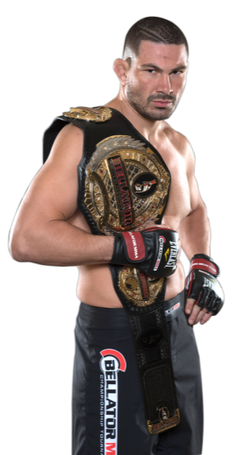
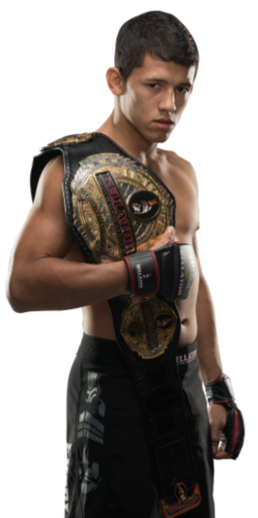
BELLATOR. THE ONLY MMA LEAGUE WHERE THE DESTINY OF A CHAMPION…
…RESTS IN THE HANDS OF
EACH FIGHTER
http://www.bellator.com/Fighters.dbml

Slide 2
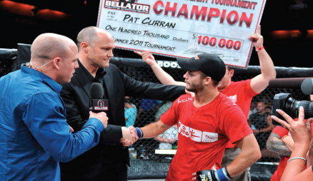
A NEW CHAPTER
With Bellator’s premiere on Spike in January 2013, fans can watch at home or on the go as the world’s most skilled warriors battle for the title of champion week after week.
Live fights every Friday night for 11 weeks at different venues throughout North America beginning on September 7, 2013 and airing through November 2013
A tournament-style bracket that are single elimination format – win or go home!
Tournament winners get $100,000 and a title shot in their respective weight class

Slide 3
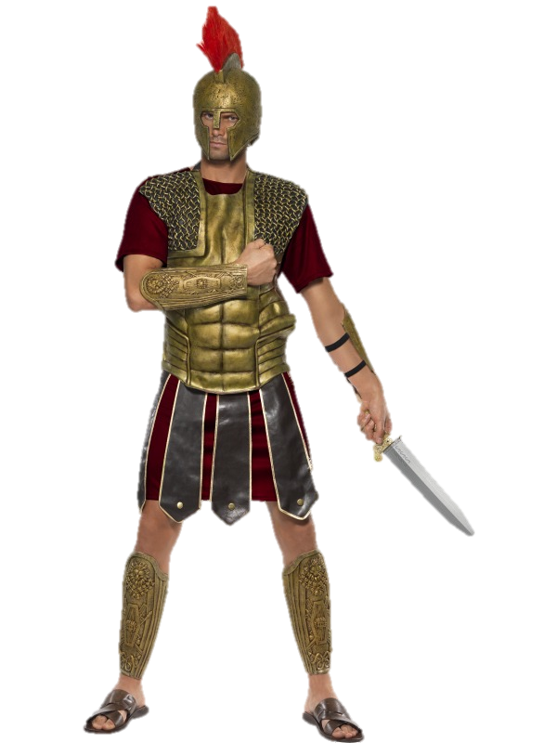
RYSE + BELLATOR
Spike’s Bellator is the perfect place to promote Xbox’s Ryse to an engaged audience, with a platform that is organically relevant to Ryse’s gladiator theme.
A NATURAL FIT
Bellator translates to “Gladiator” in Latin and the logo features a gladiator helmet – creating a seamless bridge to RYSE
SPIKE FANS ARE MMA OBSESSED
1:2
SPIKE VIEWERS ARE FANS OF MMA
80%
OF SPIKE MMA FANS AGREE
“I can’t get enough of the sport, the more MMA the better”
7X
AS MANY SPIKE VIEWERS
prefer Bellator’s bracketing system vs. promoter arranged fights

Slide 4
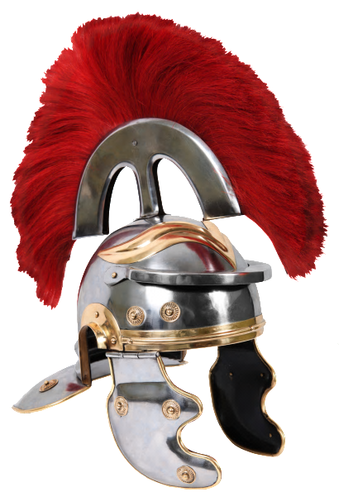
THE SEAMLESS BRIDGE
“STORIES OF THE RYSE” CUSTOM VIGNETTE SERIES
Bellator MMA is the toughest tournament in sports. And what really makes its incredible fighters stand out are their compelling stories. It’s what drives them to train relentlessly and battle their way through the bottom rungs of the tournament in order to rise triumphantly as Bellator champions.
"Stories of the Ryse“ will seamlessly align our properties by highlighting immersive gameplay with background and key messaging points.
These compelling, eye-catching vignettes will focus on the advent of Marius in Ryse, as it perfectly mirrors the stories of Bellator MMA athletes battling to the top.

Slide 5
TAPPING INTO TALENT
BELLATOR’S GLADIATORS
As part of the partnership, Spike will approach Bellator MMA fighters and coaches to be a part of the custom series, focusing on their experiences as a fighter on the rise.
With a breadth of dynamic talent from Michael Chandler to King Mo, these breakout star fighters pour heart, charisma and perseverance into their matches – the perfect parallels to Ryse’s Marius and his story arch in the game.
SOCIAL & EDITORIAL
Spike will endeavor to pursue our fighters’ social and editorial support to spread the word, looking to utilize talents’ social footprint on Facebook and Twitter to promote the partnership.
*Pending approval and athlete availability

Slide 6
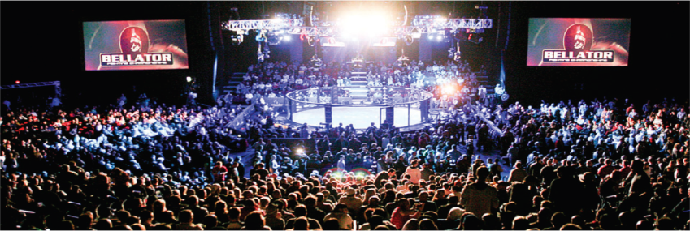
“STORIES OF THE RYSE”
This custom series will kick off on-air and be featured across all platforms, with additional marketing and media support across on-air, digital, mobile, on-site, plus editorial and social promotion.
Pod Buster Vingette
On-Air Integration
On-Site Activation/Signage
Rich Digital Experience
Interactive App
PR Opportunities

Slide 7
ON-AIR
In addition to the customized vignette series, Spike’s “Stories of the Ryse” partnership will include the following on-air promotional placements:
CUSTOM TUNE-IN CAMPAIGN
Custom tune-ins and call-to-action bursts that integrate Ryse’s key branding and messaging
Call-to-action (:05) “Follow Stories of the Ryse series at Spike.com now.”
Bumpers driving to GT App on Xbox Live to watch Prelims
IN-SHOW FEATURED FIGHT REPLAY SEGMENTS
Ryse will own 6 in-show Fight Replay featured segments throughout select episodes Season 9 of the Bellator series, allowing fans to witness the key moments and winning move of each match
BRANDED FIGHT ANNOUNCEMENT
Ryse verbal mention by the Bellator in-cage announcer after the “Stories of the Ryse” custom spot airs, driving online to view extended content

Slide 8
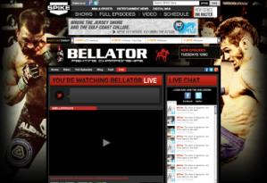
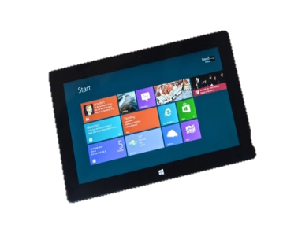
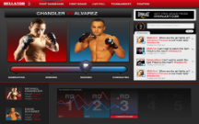
DIGITAL ENGAGEMENT
The entire season of Spike and Ryse’s “Stories of the Ryse” will live on Bellator’s digital destination, complete with showcase opportunities like:
Branded Corner Cam footage during Prelim breaks
Exclusive behind the scenes and bonus footage
Preliminaries bumpers
In addition to the complete digital experience, Ryse’s partnership will give fans access to Bellator anywhere. Exclusive live streaming includes:
Co-branded live stream page
Custom co-brands
Promotion for live streaming preliminaries
*App available only on iOS products

Slide 9
XBOX LIVE EXCLUSIVE
FOR THE FIRST TIME EVER, WE’LL AIR THE PRELIMS EXCLUSIVELY ON XBOX LIVE.
WE’LL AMP UP EXCITEMENT TO THE RELEASE OF THE GAME, WITH XBOX OWNERSHIP OF THIS SPECIAL FAN EXPERIENCE HIGHLIGHTING THE NEW RYSE ROAD TO ROME GAME.

Slide 10
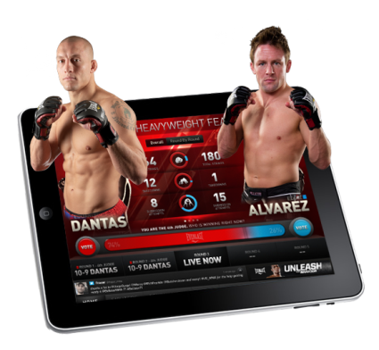
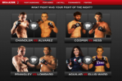
INTERACTIVE APP & MOBILE*
For the perfect viewing companion, the Bellator MMA iOS app is dynamically programmed to make watching LIVE fights richer. It allows fans to compare fighters and historical statistics to make their pre-fight picks, watch exclusive videos, and dig deep into robust bio pages.
Ryse will bring fans the action wherever they are in the fan favorite Bellator MMA iOS app including branding on a “presented by” welcome screen and brand placements within the iOS app.
FIGHT PICKS: PRE-FIGHT
Promotes tune-in to the live fight
Users vote on their fight predictions
Educate fans on fighter stats
THE 4TH JUDGE: LIVE FIGHT
Fans act as “fourth judge” by giving their feedback on who’s winning – and their commentary is shown on-air!
Real time interactive fight stats
FIGHT OF THE NIGHT: POST-FIGHT
Fans vote on “fight of the night”
Share video clips & comments
*App available only on iOS products

Slide 11
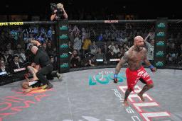
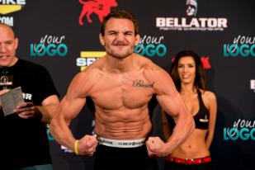
ON-SITE
All eyes on Ryse with premiere brand exposure and extensive on-site integration throughout Season 9 tournament coverage including:
Season 9 Tournament (6 fight weeks)
Ryse branding on mat signage and cage posts
Televised in-cage announcements driving fans online for more “Stories of the Ryse” content
In-arena commercials
Branded round cards
Weigh-in/Press conference integration
On-site gaming booths for fans to engage and interact with Ryse first-hand
*Pending venue approval
*Mat Integration Deadline 8/15

Slide 12
SOCIAL & EDITORIAL
PROMO BUTTONS
BLOGGER OUTREACH
SPIKE HANDLE SOCIAL AND EDITORIAL ALERTS
SPIKE & BELLATOR MMA HOMEPAGE PROMOTION
PRESS RELEASE, MEDIA, & EDITORIAL TOUTS
*Facebook and Twitter spots are unbranded

Slide 13
PROMOTIONAL ELEMENTS
To create strategic, consistent support of Ryse Gladiator Challenge/ Road to Rome, Spike will create complementary editorial content to support the rich show sponsorship elements below.
Promotional Window: 6 weeks (10/11 – 11/22)
Season 9 Tournament (Elements per week)
On-Air
1x :60-:90 second Profile Pieces (Paid Time)
5-10x :30 Bellator custom tune-ins (Promo Time, total 45 across entire flight)
1x Fight Replay feature segments (In-Show)
1x Bellator call-to-action bursts tagged w/ Ryse logo and messaging (Promo Time)
2x Bumpers teasing to Xbox Live exclusive Prelim coverage (Promo Time)
1x in-cage announcements to air in premieres and encores (Promo Time)
Digital
GT App on Xbox Live to exclusively stream Bellator Prelims
Bellator show page and live streaming page sponsorship for period of promotion
Corner Cam during prelim live stream including audio mention and lower left video bug
Co-branded media
Spike homepage massive
social and editorial promotion
Mobile
Bellator iOS App fixed media
branded logo integration
Ryse branded billboards
pre-roll for period of promotion
On-the-Ground
OTG Integration at 6x live fights including:
2x side logos mat signage and cage posts
in-arena commercials
weigh-in/press conference integration
on-site gaming booths at each fight
Production Costs:*
*Pending production approval. Subject to change.
On-Air/Digital: $50K-$75K
Talent fee: $5k-$25K*
OTG: $0-15K**
*Pending talent availability
**Subject to level of complication in arena
*Pending venue approval

